Slide 1




PokéStudy
Pokémon Themed Group Study Application
Gamifying Your Study Sessions
Team Members: Sagar Satra
Yuxuan Chen
Aditya Yendhe
INFO6205 - Final Project Presentation – By Team "Stack Underflow"

Slide 2
Problem Description
Our Solution
Challenge
PokéStudy
Students struggle with self-discipline when studying remotely
1
A gamified group study platform that combines Pokemon evolution mechanics with virtual study rooms to create an engaging, accountable study environment.
✓ Real-time group accountability ✓ Gamified study incentives ✓ Visual progress tracking ✓ Pokémon evolution rewards ✓ Distraction-free study rooms ✓ Consistency-based achievements
Lack of accountability when studying alone
2
No engaging way to track study progress
3
Difficult to maintain motivation over time
4
Limited social connection in virtual study environments
5

Slide 3
2. Analysis & Research - Project Topic
Gamification in Learning
Accountability & Group Study
Focus & Study Behavior
• Improves engagement and motivation
• Uses rewards and progression to sustain effort
• Students struggle with solo focus
• Structured environments improved discipline
Peer visibility increases consistency
Collaborative environments improve outcomes
References:
https://en.wikipedia.org/wiki/Gamification_of_learning
https://en.wikipedia.org/wiki/Active_learning
https://www.frontiersin.org/journals/psychology/articles/10.3389/fpsyg.2023.1253549/full

Slide 4
2. Analysis - Technology Perspective
• JavaFX:
Modern UI with CSS styling, smooth animations for Pokemon evolution
• Custom data structures:
UserStore manages all user sessions, authentication, and state using our own ADT implementations instead of relying on external databases
Use of Singleton design pattern to initialize some services only once and sharing their instances across application for efficient data tracking and state maintenance
• Use of Design Pattern:
• Maven Build:
We selecting Maven architecture for better management of dependencies and feature installations
• Service Oriented Architecture:
Relying on Mode, View (UI) and Service architecture for better segregation of code as per industry practices

Slide 5
3. Design: Application Architecture - Service-Oriented Architecture
PRESENTATION / UI LAYER / View
JavaFX UI Classes (Root Package): Login UI | Lobby UI | Register UI | Room Search UI | Room Creation UI | Study Room UI | Trophy Collection UI | Pokemon Card UI | Participant Card UI | Notification Popup | User Profile UI
LeaderboardView.fxml + LeaderboardController.java (the only controller) + leaderboard.css
SERVICE LAYER (Business Logic)
Auth Service | DataInitializer | Leaderboard Service | Notification Service | Pokemon Service |Room Manager | Study Timer | User Store
MODEL LAYER (Data Classes)
IMPLEMENTATION (DATA STRUCTURES)
Resizable Array Bag
ArrayList Implementation
HashMap Implementation
4. Queue Implementation​
5. Sorting Implementation​
6. LinkedList Implementation​
User | Study Room | Pokemon | Trophy | Notification | Action Record | LeaderboardEntry | (Plain POJOs with getters/setters)
ADT LAYER
Bag Interface
List Interface
Map Interface
4. Queue Interface​
5. Sort Interface

Slide 6
3. Design: System Design - Multi-User Multi-Study Room System Architecture
JavaFX Application Layer
• Pure JavaFX UI classes (no FXML except Leaderboard)
• Event-driven architecture with button handlers
• Observer pattern for real-time UI updates
• Timer threads using ExecutorService
Service Layer
In-Memory Data Structures
• Pokemon evolution logic
• Room management
• User authentication
• Notification queueing
• Merge sorting
Trophy Tracking
Study Time Tracking
Room Time Tracking
Room Search
User Activity Tracking
MapInterface<User, RoomStatus> userStatusMap​
MapInterface<User, Long> studyTimeMap​
MapInterface<String, User> users​
MapInterface<String, String> passwords;​
BagInterface<Trophy> trophyBag
ListInterface<ActionRecord> actionHistory
QueueInterface<Notification> notificationQueue
MapInterface<String, StudyRoom> rooms
Key Design Characteristics
Service layer handles ALL business logic except Leadership Controller
UI layer is pure JavaFX + CSS for Styling
Only 1 FXML file with controller: LeaderboardView.fxml + LeaderboardController
Custom ADTs for various feature implementations
Concrete Implementation of these Custom ADTs store various data for application working
Merge Sort Algorithm for user stats sorting and displaying on Leaderboard
Leaderboard is sorted based on Trophy count. In case there is a tie between users, studied time is compared to rank the users.

Slide 7
3. Design: Data Structures, Implementation, Use Cases and Efficiency Analysis
Data Structure | Implementation | Use Cases | Time Complexity
MapInterface<User, RoomStatus> userStatusMap | new HashMapImplementation<>(); | Storing users and Room status | O (1) - Put, Remove, Get, Contains
MapInterface<User, Long> studyTimeMap | new HashMapImplementation<>(); | Storing users and total study time | O (1) - Put, Remove, Get, Contains
MapInterface<String, User> users | new HashMapImplementation<>(); | Storing username and User Object | O (1) - Put, Remove, Get, Contains
MapInterface<String, String> passwords; | new HashMapImplementation<>(); | Storing username and hashed password | O (1) - Put, Remove, Get, Contains
BagInterface<Trophy> trophyBag | new ResizableArrayBag<Trophy>(); | Storing Trophy Objects | O(1) - Add, O(n) - Other operations

Slide 8
3. Design: Data Structures, Implementation, Use Cases and Efficiency Analysis
Data Structure | Implementation | Use Cases | Time Complexity
QueueInterface<Notification> notificationQueue | new QueueImplementation<>(); | Storing users' notifications | O(n) - enqueue, dequeue, clear. O(1) - getFront, isEmpty
ListInterface<ActionRecord> actionHistory | new LinkedListImplementation<>(); | Storing users' action history | O(n) - Add, remove, get, set, contains, etc.
MergeSortImplementation sorter | new MergeSortImplementation(); | Sorting users by Trophy Count for leaderboard | O( n log n)
ListInterface<LeaderboardEntry> globalLeaderboard; | new ArrayListImplementation<LeaderboardEntry>(); | Storing LeaderboardEntry object with user stats for Leaderboard sorting | O(n) - Add, remove, contains, etc. O(1) - Get, Set
MapInterface<String, StudyRoom> rooms | new HashMapImplementation<>(); | Storing all room Ids and StudyRoom object | O (1) - Put, Remove, Get, Contains

Slide 9
3. Design: Flow Chart
App Starts
User Login/
Registration
Logout
Lobby UI – Browse list of Public/ Private Study Rooms
Click Leaderboard
Click Public / Private Room
Click Room Creation
Click Room Search
Click Profile
Global / Room Leaderboard UI
Study Room UI
Room Creation UI
Room Search UI
Profile UI
Service Assigns random Pokémon
Service starts timer
Enter details
Take Break / Resume
Study Timer Starts / Pause
Enter Room Name
Capacity
Duration
Public / private
Password for private
Search By Name
Show popup
Notification Service
Pokémon Evolves
List of Room Appears – Click on enter
Click Create
Check Room Leaderboard
New Room Created
Trophy Collected

Slide 10
4. Implementation: Tools
🎨
⚙️
🔧
Build & Tools
Frontend
Backend
• JavaFX 21
• Java 17/21 (LTS)
• Maven
• FXML
• Maven 3.9.14
• Eclipse IDE
• CSS Styling
• Model, View, Service Pattern
• Git/GitHub
• Service Layer
• Used AI for styling

Slide 11
4. Implementation: Key Features
Pokemon Evolution System
Study Room Management
✓ Random starter Pokemon on room join
✓ Public & private rooms with passwords
✓ Auto-evolve at 30 min & 60 min milestones (For demo purpose time kept at seconds)
✓ Admin controls (timer, capacity)
✓ Trophy collection in user profile
✓ Real-time user status updates
Gamification & Tracking
Notification System
✓ Daily study streak counter
✓ PriorityQueue for event ordering
✓ Global & room leaderboards. Sorted based on Trophy count. In case there is a tie between users, studied time is compared to rank the users.
✓ Leaderboard top alert
✓ Pokemon Evolution milestone notifications
✓ Action history with timestamps

Slide 12
5. Results: Demo Scenarios
Live Demo Coverage
1
User Registration & Login
Create new account, login with credentials, password hashing verification
2
Browse & Join Public Room
View available rooms, join room, receive random starter Pokemon
3
Create Private Room
Set password, configure capacity & timer, invite-only access
4
Study Session & Evolution
30-seconds timer → Pokemon evolves → Notifications trigger
5
Leaderboard & Profile
View global rankings, check Pokemon collection, study streak

Slide 13
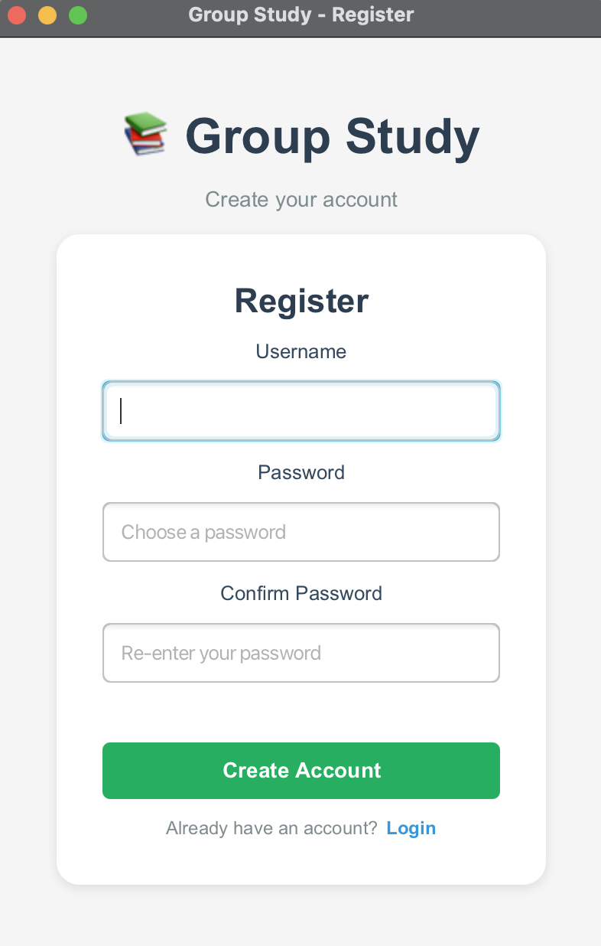
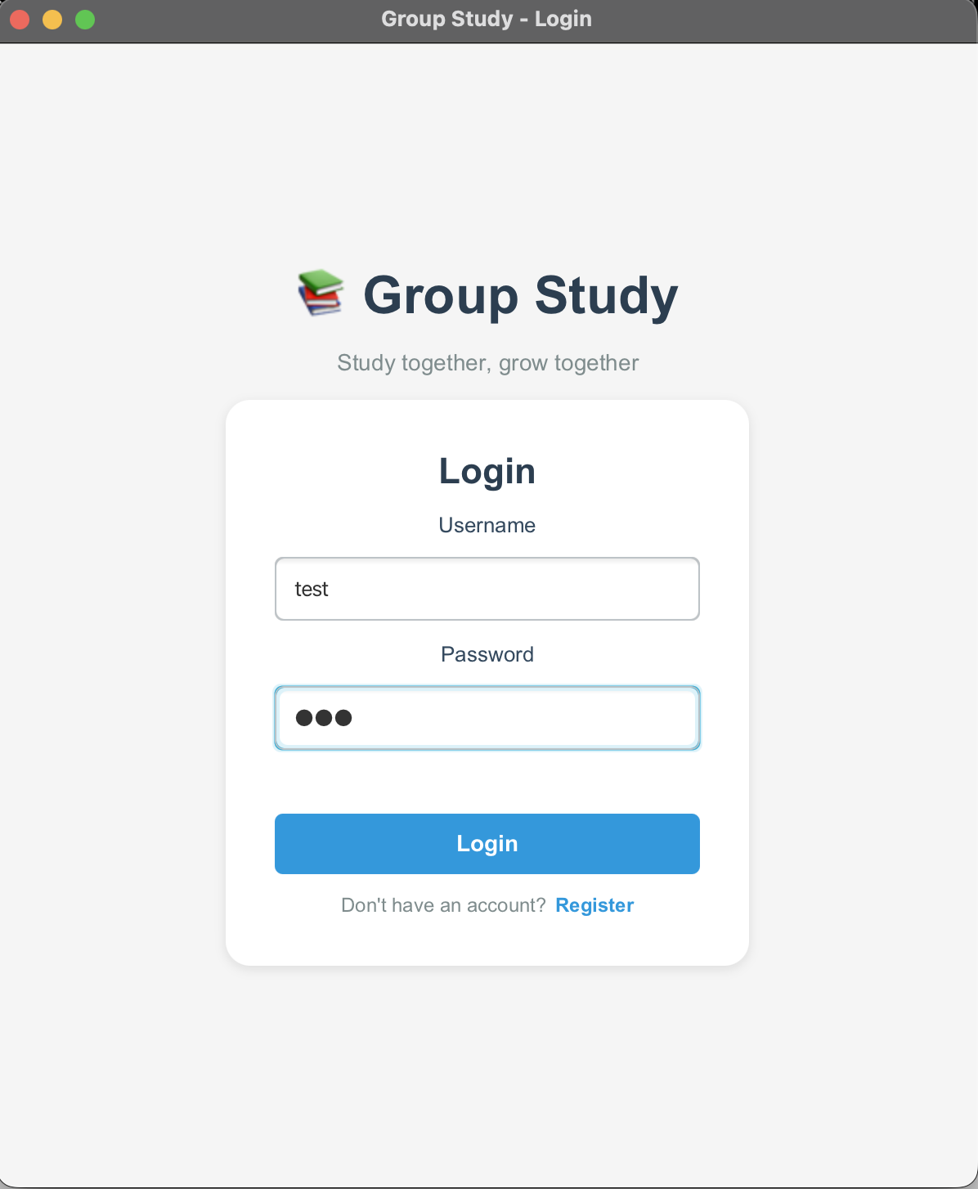
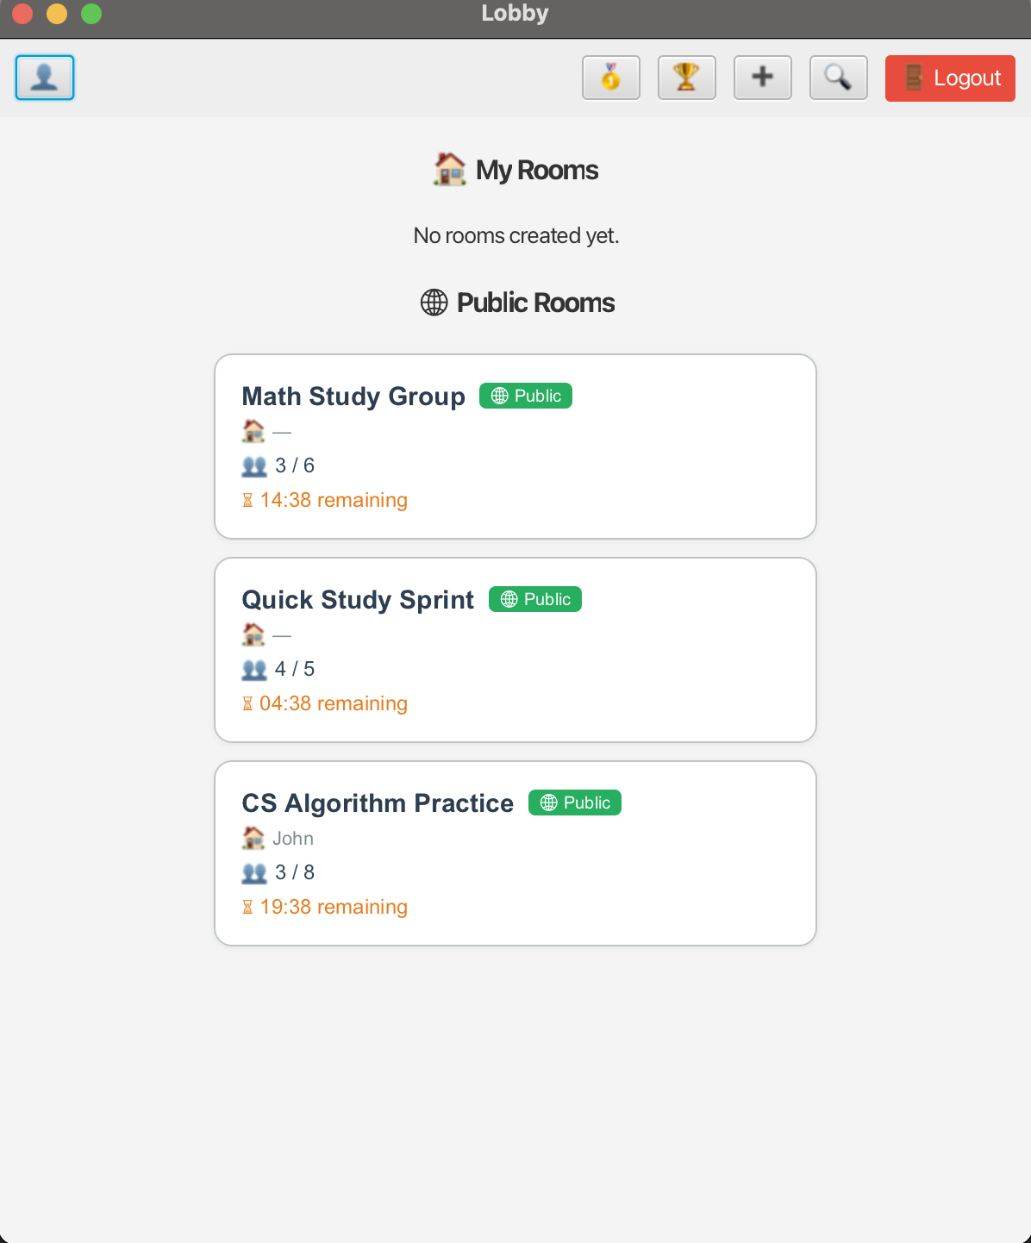
5. Results: Demo Screenshots
Registration Screen
Login Screen
Lobby UI

Slide 14
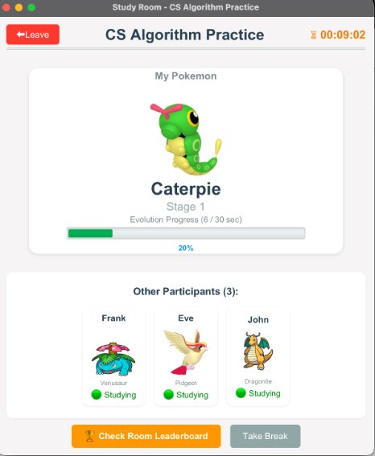
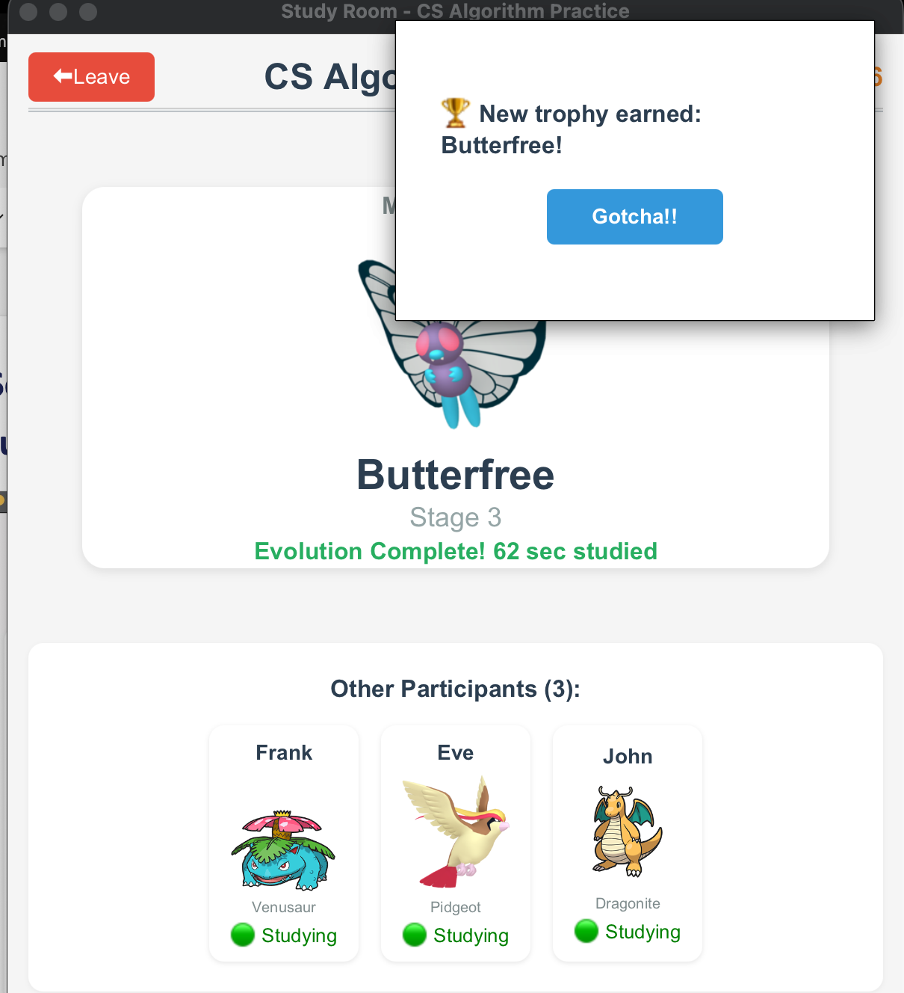
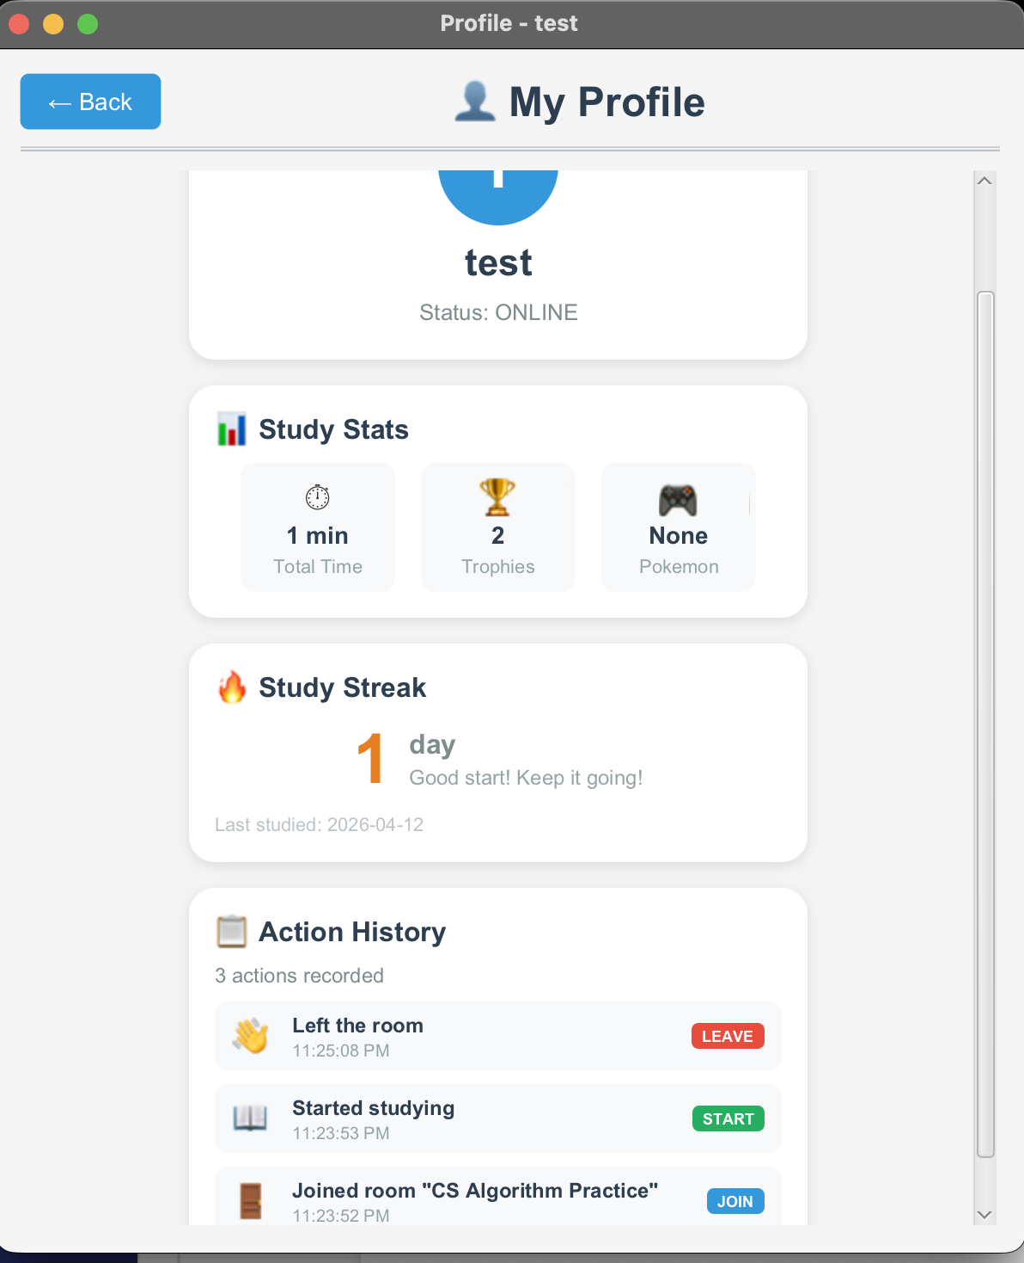
Study Room Screen
Pokémon Evolution Notification
Profile Screen and Activity History

Slide 15
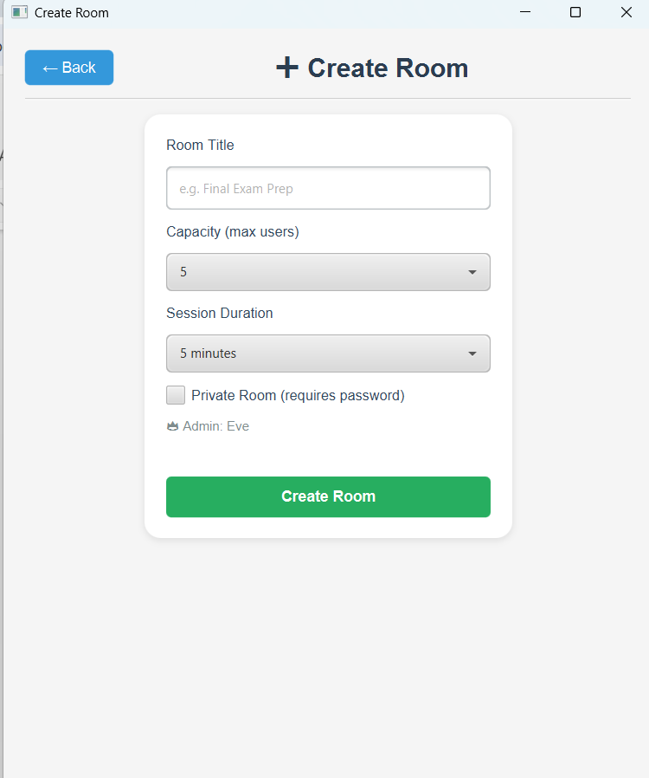
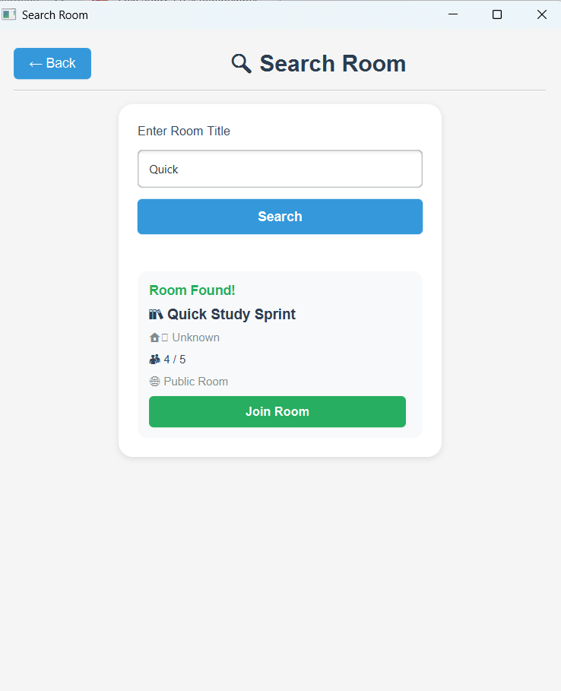
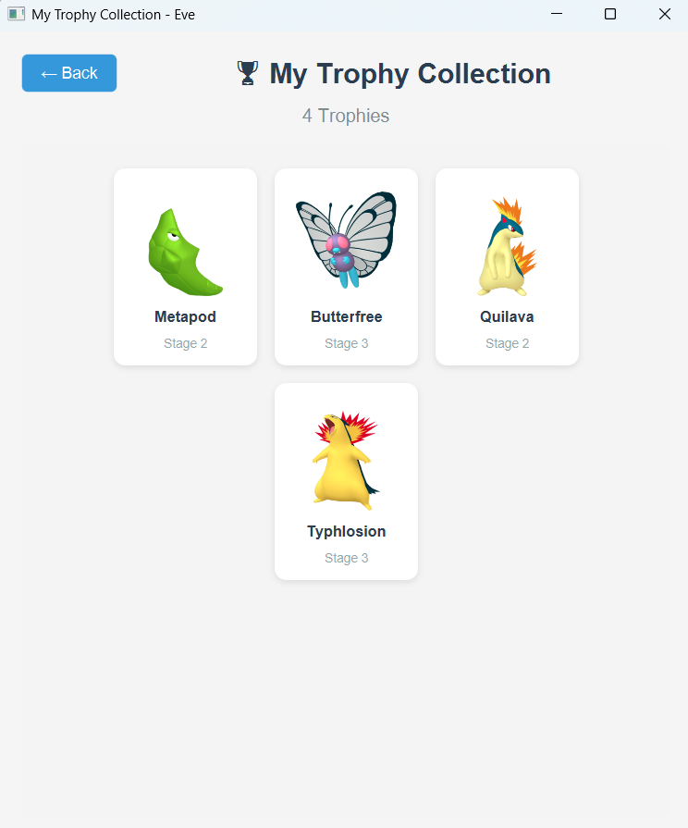
Create Room Screen
Searching room UI + Search Results
Trophy Collection

Slide 16
6. Discussion: Challenges & Solutions
⚠️ JavaFX Version Compatibility
Solution: Standardized on JavaFX 21 with Maven, avoided mixing versions across team
💡 Dependency management is critical for team projects
⚠️ Real-time User Status Sync
Solution: Implemented Observer pattern with event listeners for instant UI updates.
💡 Design patterns solve complex state management
⚠️ Real-time Study Session Tracking
Solution: Used Singleton pattern with custom HashMap Implementation to store all user, room, and session data in-memory
💡Singleton + custom ADTs can replace database layers for applications

Slide 17
7. Conclusions & Future Work
Key Takeaways
Future Enhancements
Inviting Friends to Study Room
✓ Successfully implemented all the mentioned core features
Sending request and Connecting via Sockets
✓ Successfully implemented custom ADTs and their implementation (Data structures) to improve most O(1) and O(n) operations
AI Study Buddy
AI integration for Q&A
✓ Gamification significantly improves user engagement
Video Chat
WebRTC for face-to-face study
✓ JavaFX + Maven enables professional UI development
Custom Themes
✓ Team collaboration via Git and Github for enhanced code quality
Beyond Pokemon (Marvel, Anime)
Analytics Dashboard
Detailed productivity insights

Slide 18
8. Job Assignments – Team Member Contributions
Team Member Name | Contributions
Sagar Satra | Pokemon evolution system Room UI Trophy collection logic and UI Notification system Leaderboard system ADT (List, Queue, Bag, Sorting) Data Structure Implementation (ArrayList, Queue, Resizable Array Bag, Merge Sort) PPT Content
Yuxuan Chen | Time tracking Hashing ADT HashMap implementation Room status management User status management Room search logic Room creation logic
Aditya Yendhe | User management Room management Profile UI Search UI Lobby UI Authentication screen Linked List implementation

Slide 19
Thank You!
Questions & Live Demo
PokéStudy - Gamifying Study Sessions

